Slide 1

Signal Translating Signs, Empowering Voices
By Group 3 – Aarav D, Abhijay S, Divyansh D, Ritam C, Rushil S, Vignesh S

Slide 2
INDEX
01
Introduction to the Website
02
Contribution of Members
03
Future of Project
04
Link to Github

Slide 3
Introduction to the Website
01

Slide 4
Contribution of Members
02

Slide 5
Contribution of Members
1.
Aarav Dalal
2.
Abhijay Sarmah
Innovation
Design
PPT and Information
Training Model
Divyansh Dwivedi
Ritam C.
3.
4.
Coder
Leader
Coder
Model Making

Slide 6
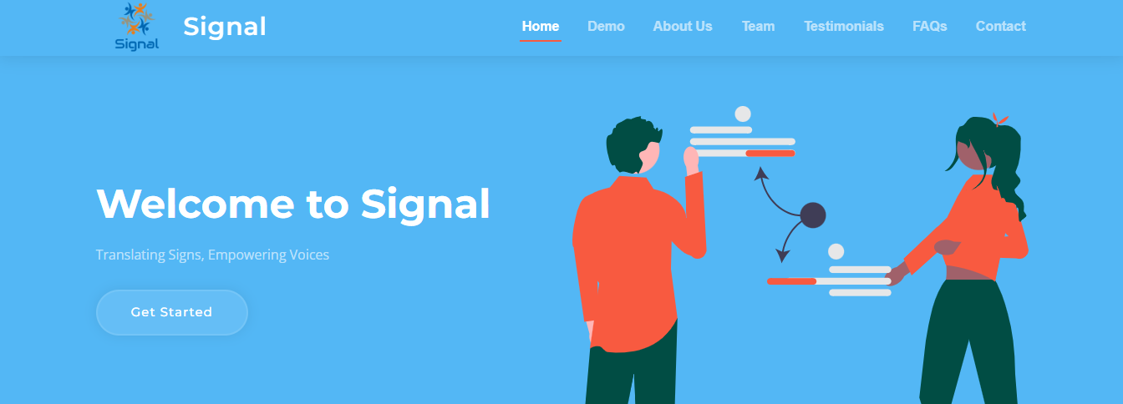
Contribution of Members
5.
Rushil Srinivas
6.
Vignesh Shekar
Coder
Frontend
Coder
Frontend

Slide 7
Future of Project
03

Slide 8
Future of Project
Making the model better and accurate
Making it more accessible
Making it in an app based system
Incorporate more sign languages in the future
Strengthen the voice-sign language translator
Make the voice-sign language adaptable to more languages and accents
Try translating and helping in the rural and less-fortunate sections and regions of India
Make the program compatible with live translation
Increase the efficiency and speed of the program when recognising sign language

Slide 9
Link to Github
04
https://github.com/SignalNPS/Signal-OP
Link

Slide 10
THANK YOU
Please contact signal.npsinr@gmail.com for any further queries
Contact: +91 99457 01406

